Slide 1


COP290
ASSIGNMENT 2
SUBTASK 2
SABHYA KHURANA AND ABHIRAM DHARME

Slide 2

INTRODUCTION
IITD-GUESSR
IITD Campus Guesser, a dynamic and interactive game designed to cater to both introverted and extroverted players. Built using the Pygame framework, this game offers a variety of gameplay modes that allow users to engage at their comfort level while exploring the vibrant campus of IIT-Delhi. Whether you prefer to play solo or enjoy competing against others, IITD-Guessr provides an engaging platform to test your knowledge and observational skills.
2

Slide 3

PROJECT AIM
1
To create a game which is not restricted on someone’s personality type.
2
To create a game that Introverts can enjoy while playing solo or with someone they know.
3
To create a game where there is an option for people to discover their community and explore the richness of campus.
3

Slide 4
MODES
1
2
3
Hodophile:
A Pokemon Go inspired game mode, this involves navigating to the shown location and marking it to score points
Hodophobe:
This is a mode faithful to the principles of GeoGuessr, which involves guessing the location of the image on the IITD map
Versus Mode:
This is a two player mode, for the Hodophobe game mode, where each player gets a chance to mark locations
4

Slide 5
DESIGN DECISIONS
Responsiveness and Zero Latency:
We aimed to create a responsive game with minimal latency. We focussed on resizabiility so that the game is not restricted to any screen size, and could also be ported to mobile. We also added a geographical feature which updates the location in real-time, every alternate second.
5

Slide 6
DESIGN DECISIONS
2. UI
We created a simple and easily navigable UI, with colours that go easy on the eyes and a gaming experience that feels smooth and enjoyable. We settled upon the beautiful backdrop of the Main Building as our background and added customisability for the volume and the number of rounds per game.
We created a custom pointer icon for our locations and used an updated IITD campus map, along with funny images of our friends. We also implemented a leaderboard to display the top 5 scores and add an element of competitiveness.
6

Slide 7
DESIGN DECISIONS
3. Fitting of Coordinates on Map
We had the task of mapping geographical coordinates, which we recorded while clicking the images, to pixel coordinates on our screen. Since each pixel coordinate would depend on both the latitude and longitude, we used Linear Regression to find the transform from the GPS coordinates to pixels. We used two formula for distance : Haversine Distance, which is used to calculate the distance between two coordinates, and the Euclidean distance formula to calculate distance between two pixels. We also found the best fit line for the factor which related these distances and used it in the Hodophobic mode.
6

Slide 8
METRICS TO EVALUATE
A. Zero Latency
The first metric we would like to add is the zero latency factor. We worked hard to add the element of resizability, and ensured that the game is responsive and smooth, right down to the geographical mapping.
B. Real World Element
We had to find out ways to fetch the geographical locations of both Mac and Windows devices without using APIs, and had to map geographical coordinates to pixel coordinates using basic ML. We also added the option of savev games for the Hodophobic version so that people don’t have to keep the game open while moving around
C. Replayability
We added 100+ locations to minimize the chances of locations repeating so that the replayability could be ensured. We could also maintain the game and keep adding new images every week.
7

Slide 9
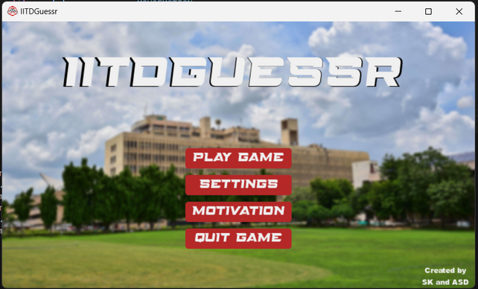
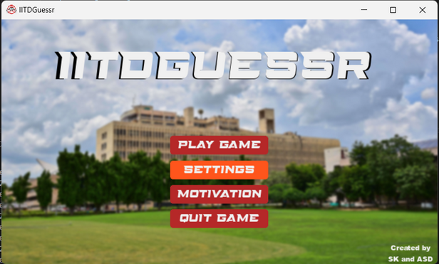
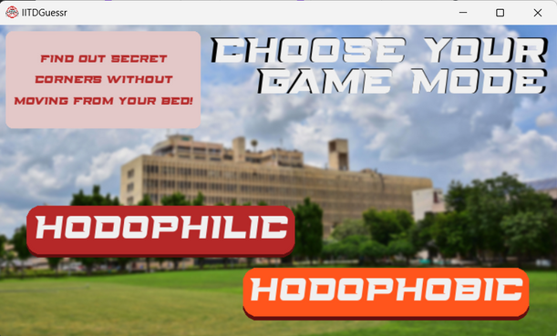
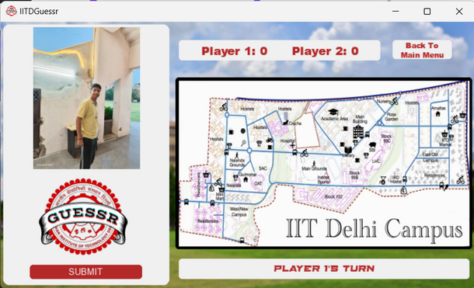
8

Slide 10
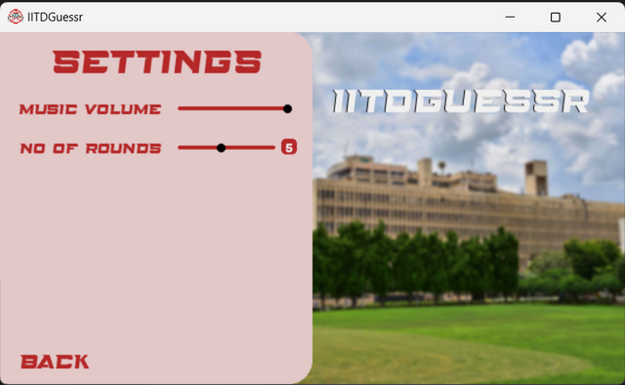
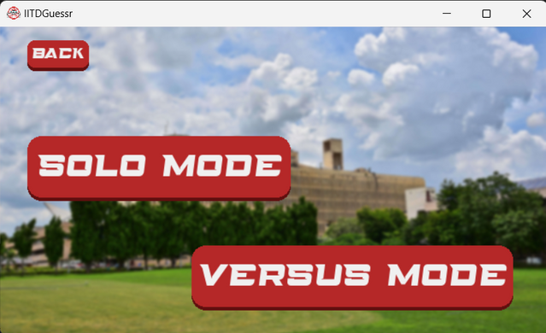
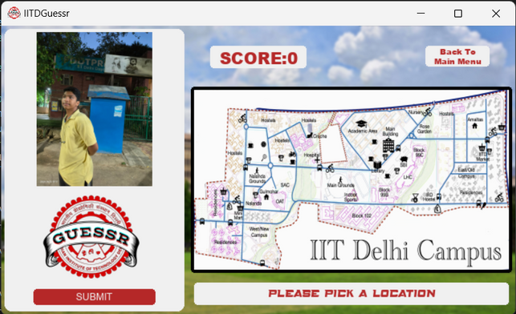
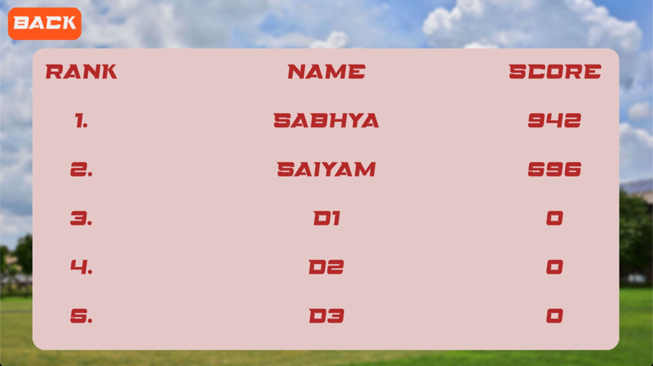
First Day
Second Day
Third Day
9

Slide 11
CONCLUSION
To conclude our presentation on the IITD-Guessr, we'd like to emphasize our commitment to enhancing the gaming experience for every user, regardless of their personal preferences on the campus. By integrating responsive design and zero latency into the gameplay, we have created a platform that is both inclusive and engaging. Our goal was to build a game that allows players to explore the vibrant campus life virtually. Thank you for your attention and we are eager to hear any feedback or questions you might have.
10

Slide 12
Thank You
FOR YOUR ATTENTION!
11

